Slide 1
Acknowledgements
Professor Ruth A. Guthrie at California Polytechnic University, Pomona, has granted a permission for this instructor to use and/or modify the PPT for her CIS310
http://www.cpp.edu/~raguthrie/CIS310/
for this MIS 315 online class.

Slide 2
Chapter 4
Data and Databases

Slide 3
Learning Objectives
Upon successful completion of this chapter, you will be able to:
Describe the differences between data, information, and technology
Define the term database and identify the process of designing one
Describe the role of a database management system
Describe the characteristics of a data warehouse
Define data mining and describe its role in an organization

Slide 4
Data, Information, Knowledge, and Wisdom
Data
Information
Knowledge
Wisdom
Data are raw facts
Quantitative – numeric
Qualitative – descriptive
Alone is not useful
Information is processed data for a given context and specific application
Knowledge is the human perception of the real world
Wisdom is the ability to apply knowledge with judgement gained from experience and study

Slide 5
Databases
Why databases, not spreadsheets, for storing data?
common defects in data resources management by using spreadsheets to store data:
Spreadsheets have no control of data redundancy
Spreadsheets do not enforce data integrity
Spreadsheets rely on human memory for search
Databases control data redundancy, maintain data integrity, and organize data.

Slide 6
Databases (cont’d)
Organized collection of related information to generate knowledge for decision making purposes
For example, a university transcript database may contain information on students, classes taken, and grades received
A separate university database would be created to maintain your financial information
Relational databases (such as Microsoft Access) where data in organized into one or more tables
Tables are a collection of fields
E.g., Student ID, Course ID, Grade Earned
Record is an instance in the table
E.g., your specific information in the table

Slide 7
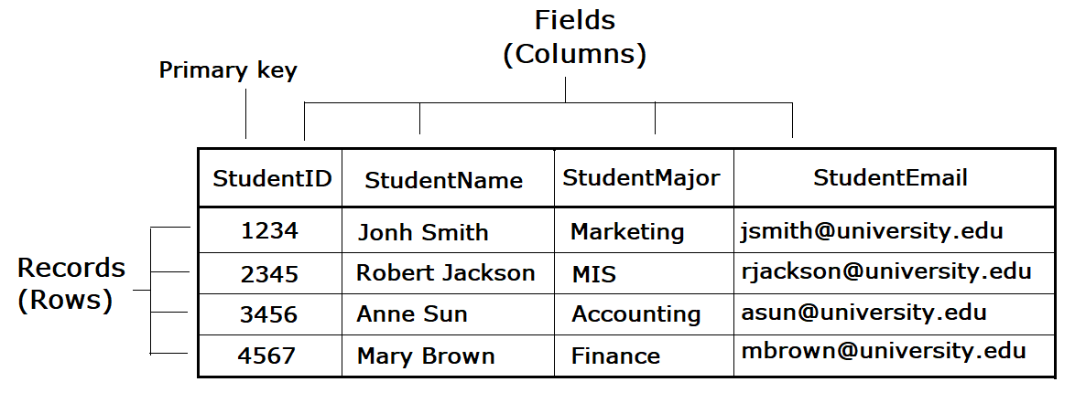
Databases continued
Rows and columns in a table

Slide 8
Database Design
Design is a critical first step in creating a database
Understand the goal of how the database will be used
Identify the data needed as part of accomplishing this goal
Identify how the data is related to each other
Identify tables and fields to organize the data
Each table needs a primary key of which field(s) is unique to each record and will not change
For example, our Bronco ID
Normalization is performed to eliminate data redundancy

Slide 9
Database Design (cont’d)
Each field in the database has a data type to store information:
Text – non-numeric data less than 256 characters
Number – numeric data
Yes/No – stores 0 for No or False and 1 for Yes or True
Date/Time – number data type that can be interpreted as a number or a time
Currency – monetary data
Paragraph Text – stores text longer than 256 characters
Object – data that can’t be typed such as a picture or music file
Data types dictate what functions can be performed on the data
For example, 2 number fields can be used to perform calculations
Data types indicate the amount of storage needed for each field

Slide 10
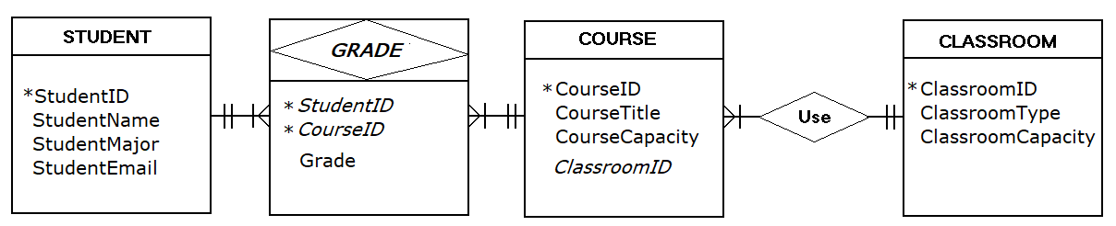
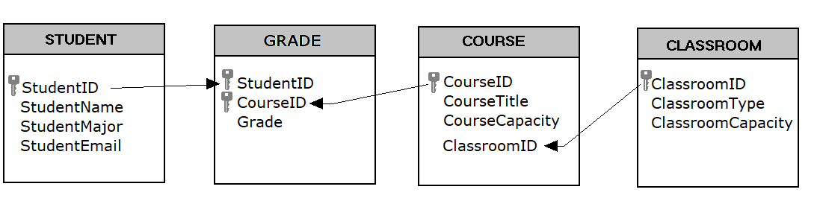
Database Design (cont’d)
Entity-Relationship (ER) diagrams are used for database design
The design viewed within the database

Slide 11
Database Reports
Structured Query Language (SQL) is a tool/language that helps extract information from the database for analysis purposes
QBE (Query by Example) is a graphical query tool, to retrieve data though visualized commands
QBE generates SQL for you, and is easy to use
In comparison with SQL, QBE has limited functionalities and is unable to work without the DBMS environment

Slide 12
Other Database Types
Hierarchical - parent/child relationship between data
Document-centric – places data into documents that can be manipulated
NoSQL (Not only SQL) for unstructured data
Business Classes
Accounting
ACC207
ACC208
Computer Information Systems
CIS101
CIS310
Finance
FRL300
FRL 301

Slide 13
Database Management Systems
Database Management Systems (DBMS) is an application that create and manage the databases
Oracle, DB2, SQL Server, MySQL
Microsoft Access is end-user-oriented DBMS for small scale databases and is easy to use
Enterprise Databases serve the entire organization

Slide 14
Data Warehouse
Consists of extracts from one or more of the organization’s databases
Allows the data to be copied and stored for analysis
Needs to be refreshed as the data changes
Data is time-stamped when extracted
Allows comparisons between different time periods
Data is standardized
All similar fields (e.g., calendar dates) are structured the same
Date is MM/DD/YYYY
Data marts are smaller subsets of data warehouses for specific business problems

Slide 15
Data Warehouse Benefits
Forces organizations to better understand the data
Centralized view of data to identify inconsistent data
Once inconsistencies are resolved, higher quality data is used to make better business decisions
Data can be analyzed over multiple time periods
Tools are available to combine data and gain more insight into business operations

Slide 16
Data Mining
Automated process of analyzing data
To find previously unknown trends, patterns, and associations
To make better business decisions
Starts with a hypothetical result in mind
Privacy concerns
Easier to combine disparate sources of information and when aggregated tell you much more about the individual
Data brokers now to sell this information
Business intelligence – collecting and analyzing information to increase their competitive advantage
Business analytics – uses internal company data to improve business processes and practices

Slide 17
Eastern Base Student File for Analysis
Data Elements | Data Elements Continued
Level | Current Town
Residence Status | State
Tuition Status | Zip
Class | Country
Matriculated | Dorm
Student Type | Cumulative Academic Credits
FT/PT | Cumulative Eastern Academic Credits
Gender | Transfer
Birthdate | Cumulative GPA
Age at Third Week Count Date | Pass/Fail
Citizen | AP Credit
Visa | Other Exam Credits
Various Ethnicity Questions | Total Exam Credits
Race Summary | Current Academic Credits
1st Generation

Slide 18
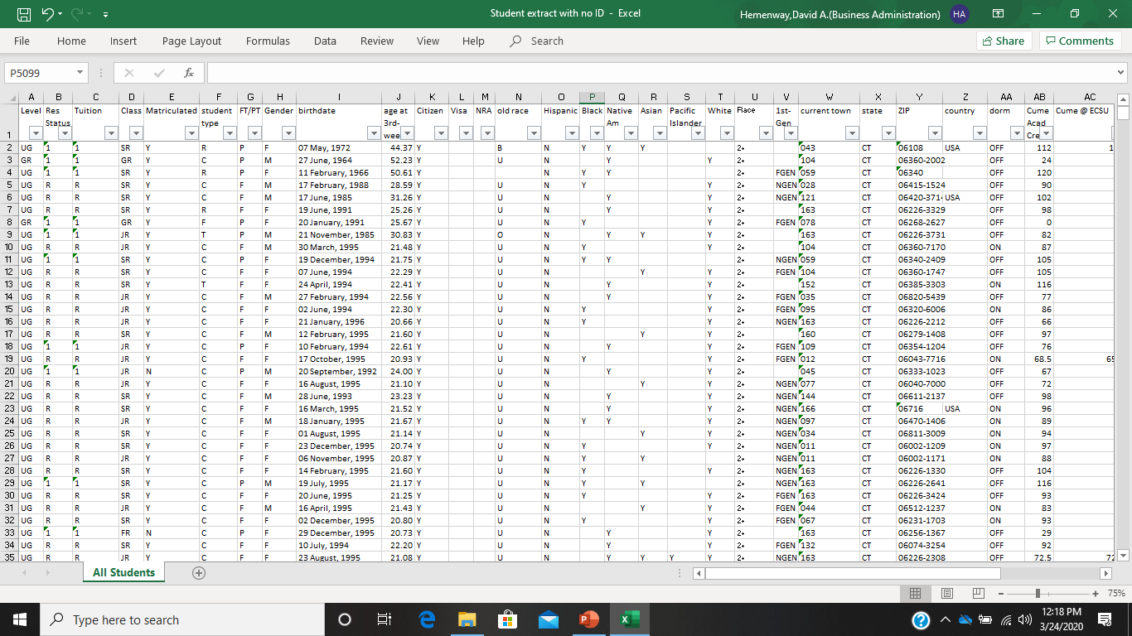
Eastern Base Student File for Analysis

Slide 19
Knowledge Management (KM)
Companies and individuals accumulate knowledge
Not consistently written down or saved
If recorded, not consistently organized
KM is the process of formalizing the capture, indexing, and storing of knowledge

Slide 20

Summary
Described the differences between data, information, and technology
Defined the term database and understanding the fundamental of designing one
Described the role of a database management system
Described the characteristics of a data warehouse
Defined data mining and describe its role in an organization

